Slide 1
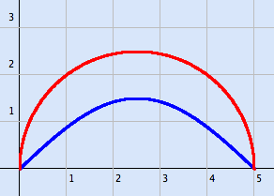
BETWEEN CURVES
Integration (actually calculus) is a very powerful tool, it gives us power to answer questions that the Greeks struggled with unsuccessfully (as did pre-calculus Mathematicians) for a very long time.
Here is a figure whose area was not computable until the advent of calculus

Slide 2
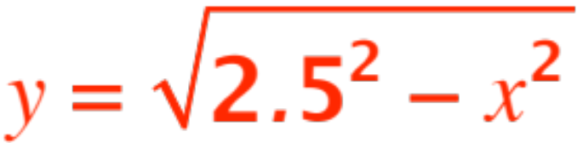

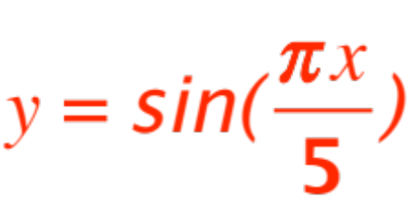
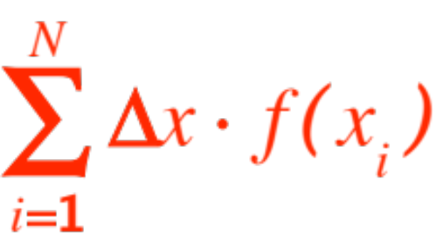
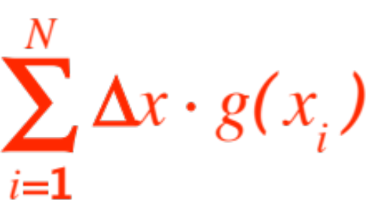


The area of the figure that looks like a crescent moon is simply the area below the curve
(a semicircle of radius )
and above the curve
In other words, it’s the area between two curves.
By now it is old hat for us. We look at the two
Riemann sums ,
( is the semicircle, the sine curve) and we look at their difference (from the figure shown)

Slide 3
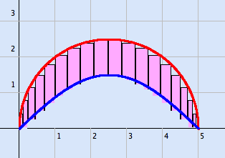
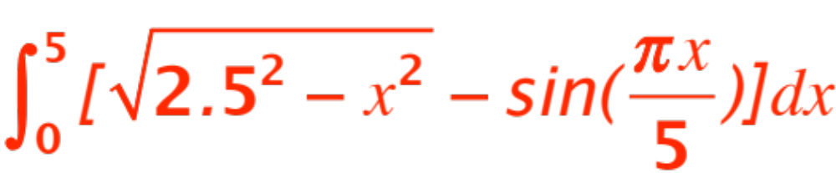

and conclude that the area we want is
(The actual computation is easier than it looks.)
I get . What do you get?

Slide 4
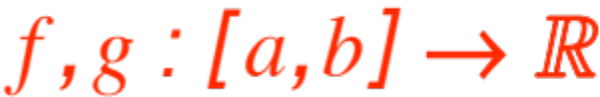
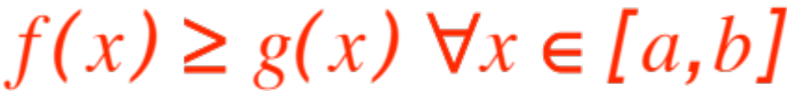
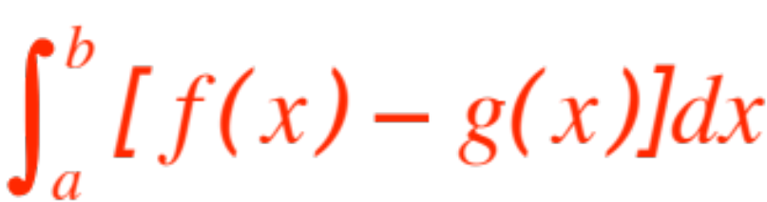
The situation can be generalized to the following
Proposition. Let be two Riemann integrable functions, with
Then the area between their graphs is given by
The following two figures provide the skeleton of a reasonable proof of the proposition .

Slide 5


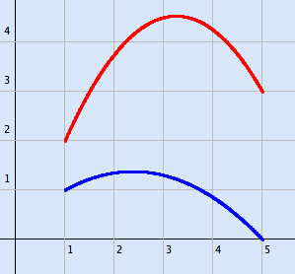
(in the figures, and .)
Fig. 1

Slide 6
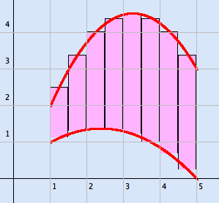
The difference of the respective Riemann sums:
Fig. 2

Slide 7
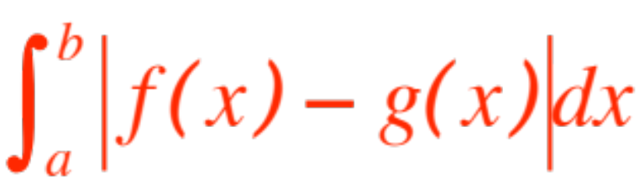
Remark. If the inequality condition in the statement of the Proposition fails, the area between the two graphs is computed as
The integral may become quite hard to compute if the points where the two graphs cross are not easy to find.
Here is an example of moderate difficulty:

Slide 8

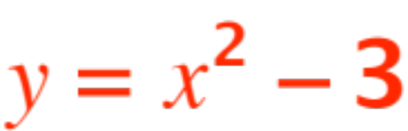
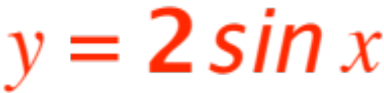
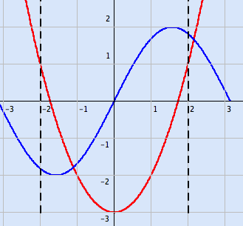
Find the area of the plane region bounded by the two vertical lines and the graphs of
and . The figure:

Slide 9
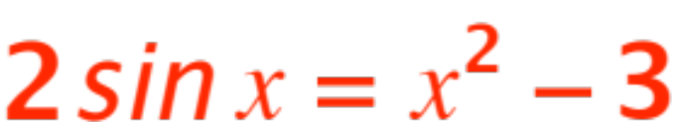


Hint: You have to find the value of that solution of
which lies between and .
How do you do that?
(I get -1.102441 ; how did I do that? )

